Slide 1
Concept of DCEG Editor and Prototype Development
NIPWG2
HB, Monaco (21-24, March 2016)
Republic of Korea (KHOA)
Notes:
Hello I’m Joon-sik Lee from KHOA, Republic of Korea.
Today, I’d like to present the research results on the concept of DECG Editor and prototype development.

Slide 2
Introduction / Background
TSMAD29 discussed
Comparison results between S-101 DCEG and Feature catalogue and a method of improving consistency of those documents
Refer to TSMAD29 10.4A and 7-10.7A
KHOA, ROK
Started the research on the concept of DCEG Editor
Developed a prototype of those
Notes:
The last TSMAD meeting discussed an agenda on the comparison results between S-101 DCEG and Feature catalogue and a method of improving consistency of those documents.
You can refer to the related agenda of last year.
KHOA has studied the method of DCEG Editor and developed a prototype since the meeting.
This presentation will introduce the result of prototype development based on the concept of DCEG Editor.

Slide 3
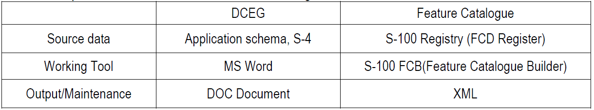
Comparison between DCEG and Feature Catalogue
S-100 based product specifications including S-101
Contain the DCEG and Feature Catalogue as an appendix document
The two document
Should contain same information on binding results between features and attribute type,
There are many inconsistencies because of the different sources and working tools
Notes:
S-100 based product specifications contain the DCEG and Feature Catalogue as an appendix document.
Although the two document should contain same information on binding results between features and attribute type,
There are many inconsistencies between those documents
In the previous agenda, it was reported that there are serious inconsistencies between DCEG and Feature Catalogue which were developed in the S-100/S-101 test bed project.

Slide 4
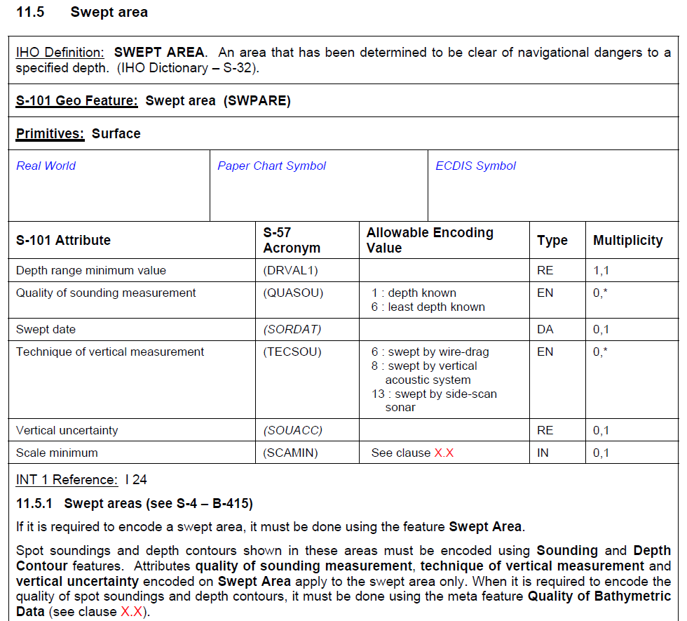
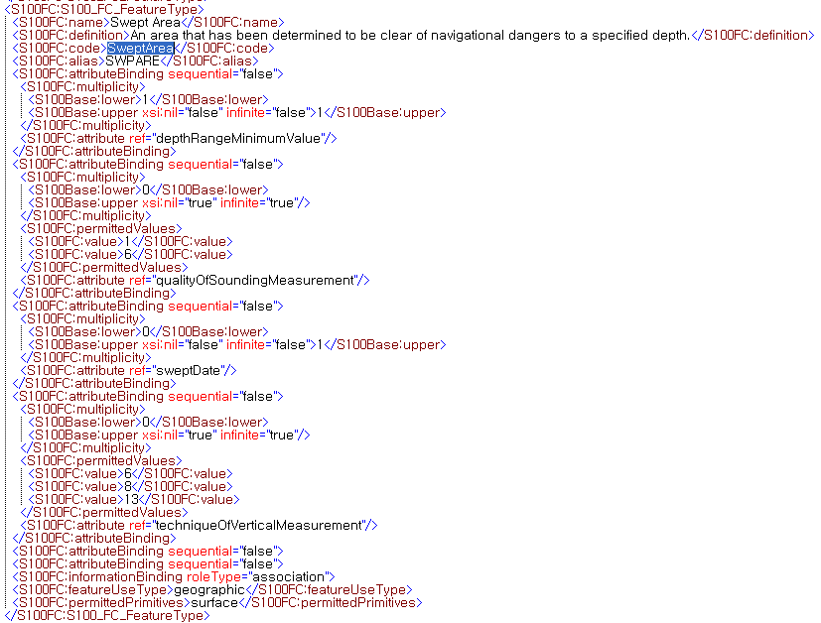
Similarities between DCEG and Feature catalogue
DCEG and Feature Catalogue
S-101 DCEG
S-101 Feature Catalogue
Notes:
This slide shows how those documents are similar.

Slide 5
Similarities between DCEG and Feature catalogue
DCEG and Feature Catalogue
Part 1
Feature Catalogue
Part 2
Encoding guide
Notes:
In this slide, Part 1 contains feature name, definition, primitives, binding results between feature and attribute and relationship on feature to feature and feature to information.
This part belongs to the feature catalogue.
Part 2 is about encoding guide like UOC(Use Of Catalogue) and S-4.

Slide 6
The Concept of DCEG Editor
The DCEG and Feature catalogue is quite similar in many parts
If those documents can be developed in an agreed working process from same source, it’s possible to secure a consistency between DCEG and feature catalogue.
Regarding the working process,
it’s recommended to adopt a sequential working process on DCEG and Feature catalogue.
Tool
UML Tool
S-100 FCB
DCEG Editor
Output
Application
Schema
Feature Catalogue
DCEG
Notes:
The DCEG and Feature catalogue is quite similar in many parts.
If those documents can be developed in an agreed working process from same source,
it’s possible to secure a consistency between DCEG and feature catalogue.
Regarding the working process, ROK propose to adopt a sequential working process on DCEG and Feature catalogue.
This figure describes the process, which the feature catalogue is compiled based on the application schema and DCEG can be developed with the feature catalogue.

Slide 7
The Concept of DCEG Editor
Working process from FC to DCEG
Encoding Guide
DB
Feature Catalogue
DB
Validation DB
HTML format
S-100 FCB
DCEG Editor
S-10X
Feature
Catalogue
XML
Notes:
This slide shows the working process from FC to DCEG.
S-100 FCB can produce feature catalogue according to the application schema
and the feature catalogue can be saved into the FC DB or external XML feature catalogue.
DCEG Editor include a function to load the FC DB or FC XML to prepare the part 1 of figure 1 in the DCEG structure.
The part of encoding guide in DCEG can be maintained in a separate DB.

Slide 8
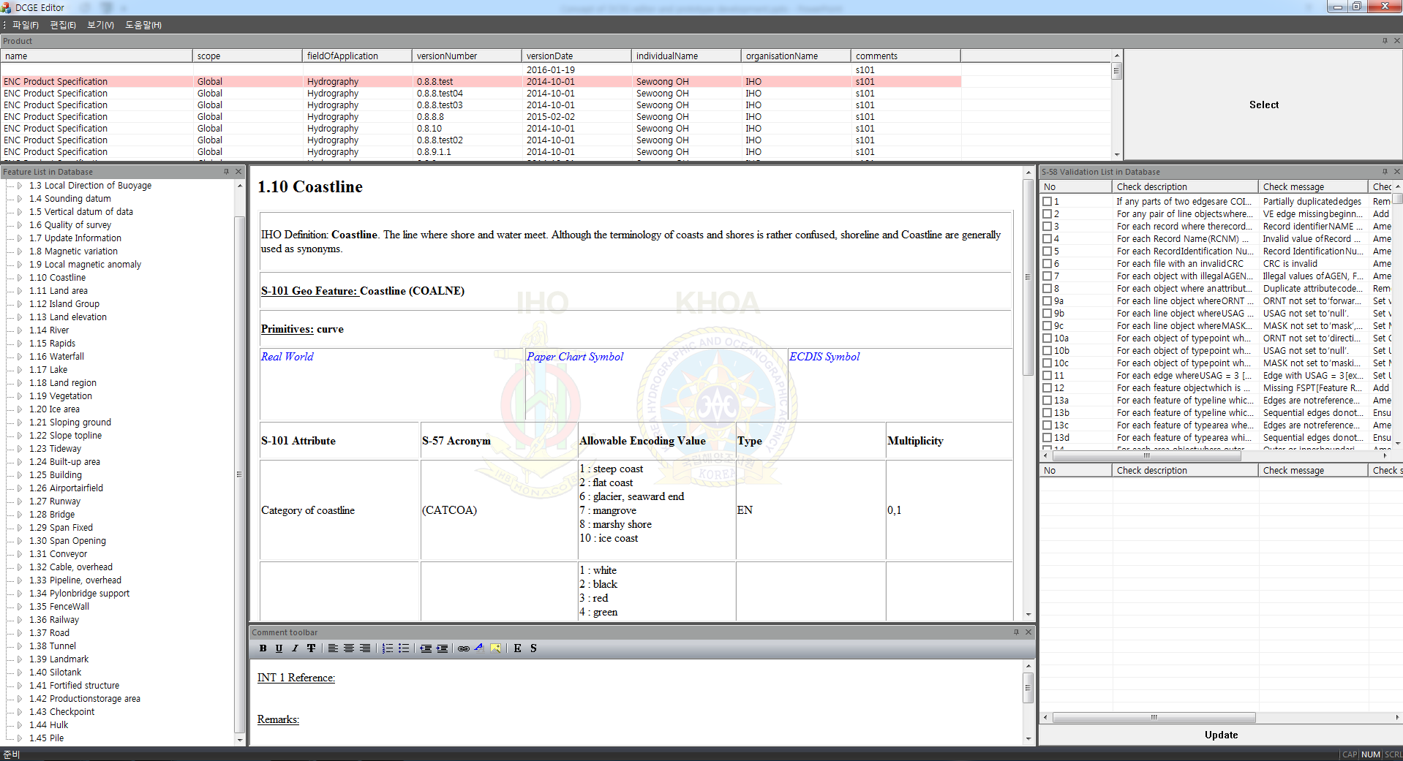
Prototype development of DCEG Editor
ROK has studied the concept of DCEG Editor and developed to implement those.
Notes:
ROK has studied the concept of DCEG Editor and developed to implement those.
S-10X feature catalogue can be loaded from FC DB in the DCEG Editor.
The part 1 of figure 1 can be built up automatically as a table form
and part 2 of figure 2 can be added into the table form.
The function to include validation rules of S-58 was also developed.

Slide 9
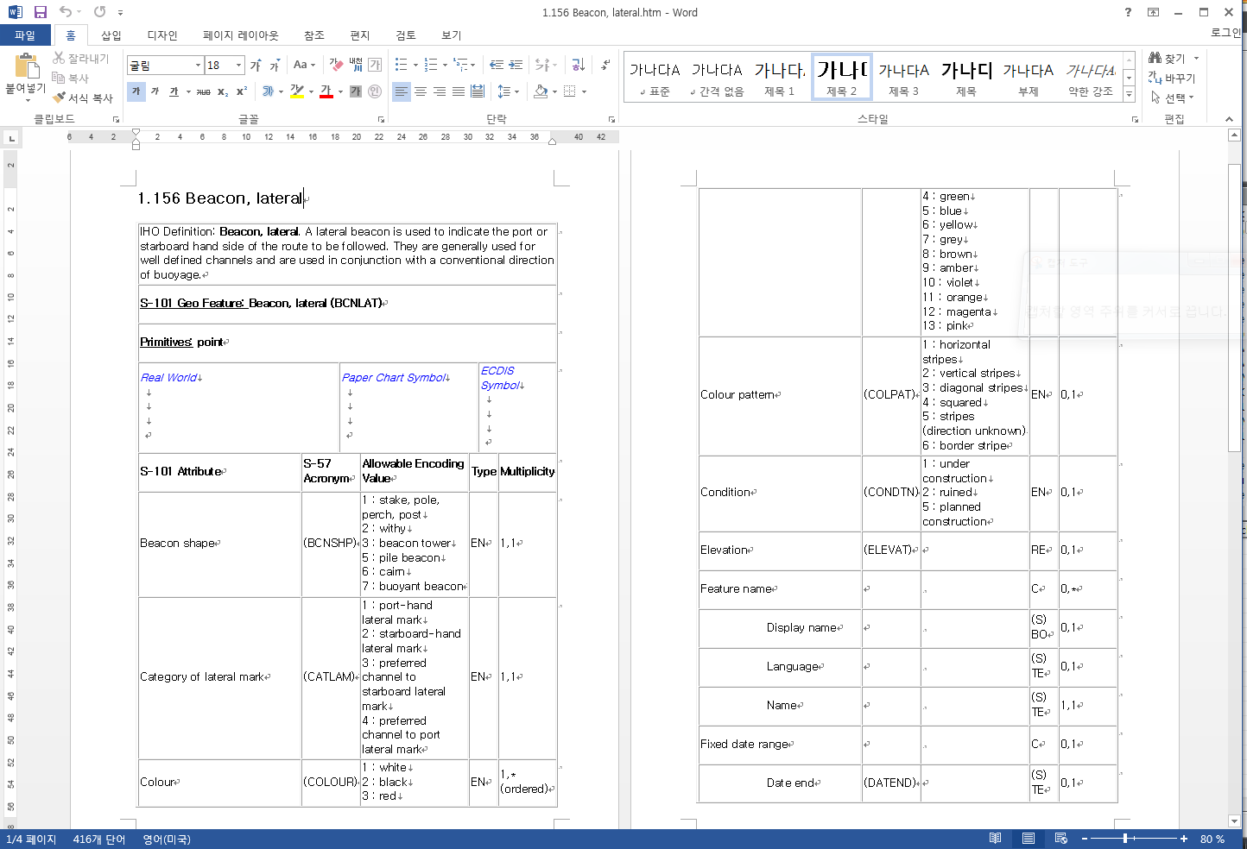
Prototype development of DCEG Editor
DCEG Editor can export the contents as HTML format, which is available to load and edit in the MS word program.
Notes:
This is an example of using the DCEG HTML document for the purpose of paper based DCEG.
DCEG Editor can export the contents as HTML format, which is available to load and edit in the MS word program.
The last TSMAD meeting discussed the need of S-101 DCEG web service.
In order to make the DCEG contents be ready for web service,
DCEG HTML files made from the DCEG Editor can be used for the purpose

Slide 10
Conclusions
KHOA and research team
has studied the concept of DCEG editor to secure the consistency between S-10X DCEG and S-10X feature catalogue.
It’s expected that the concept will support not only the consistency of S-100 PS documents but also a web service development of those contents.
Notes:
KHOA and research team has studied the concept of DCEG editor to secure the consistency between S-10X DCEG and S-10X feature catalogue.
It’s expected that the concept will support not only the consistency of S-100 PS documents but also a web service development of those contents.

Slide 11
Action Required of NIPWG2/S-101PT1
The NIPWG2/S-101PT1 is invited to:
note the progress reported in this paper.
discuss comments and considerations on the concept of DCEG Editor.
Notes:
The S-101PT1 is invited to note the progress reported in this paper and discuss comments and considerations on the concept of DCEG Editor

